Slide 1
Unit :6
File System
Operating System (OS)
Asst. Prof. Jhumi Thapa
Computer Engineering Department

Slide 2
File
A file is sequence of logical records i.e. a sequence of bits and bytes.
A file is a named collection of related information that is recorded on secondary storage such as magnetic disks, magnetic tapes and optical disks.
In general, a file is a sequence of bits, bytes, lines or records whose meaning is defined by the files creator and user.

Slide 3
File System
Module of OS which manages, control and organizes files and related structures
A file system is the methods and data structures that an operating system uses to keep track of files on a disk or partition; that is, the way the files are organized on the disk.
File system provides the view of data in secondary memory in the form of files.

Slide 4
File Descriptor
A file descriptor or file control block is a control block containing information the system needs to manage a file. It is a highly system-dependent structure. A typical file descriptor might include
  Symbolic file name, location of file in secondary storage, file organization, access control data, type, disposition(permanent vs. temporary), creation date and time, destroy date, date and time last modified, access activity counts(number of reads, for example)
Ordinarily, file descriptor are maintained on secondary storage. They are brought to primary storage when a file is opened and is controlled by the operating system

Slide 5
File Naming
When a process creates a file, it gives the file a name. When the process terminates, the file continues to exist and can be accessed by other processes using its name.
File naming = File name + File extension
E.g. bcabit.doc In this example the bcabit is the file name and doc is the file
Some common file extension are: DOC and DOCX, .HTML and .HTM,.ODT,.PDF,.XLS and XLSX, .ODS, .PPT and .PPTX ,.TXT etc

Slide 6
File Structure
None -sequence of words, bytes
Simple record structure
  Lines
  Fixed length
  Variable length
Complex Structures
  Formatted document
  Relocatable load file
Can simulate last two with first method by inserting appropriate control characters
Who decides:
  Operating system
  Program

Slide 7
File Type
File type refers to the ability of the operating system to distinguish different types of file such as text files source files and binary files etc. Many operating systems support many types of files. Operating system like MS-DOS and UNIX have the following types of files −
1. Ordinary files
These are the files that contain user information.
These may have text, databases or executable program.
The user can apply various operations on such files like add, modify, delete or even remove the entire file.
2. Directory files
These files contain list of file names and other information related to these files.
3. Special files
These files are also known as device files.
These files represent physical device like disks, terminals, printers, network, tape drive etc.

Slide 8
File Type
These files are of two types −
Character special files − data is handled character by character as in case of terminals or printers.
Block special files − data is handled in blocks as in the case of disks and tapes.

Slide 9
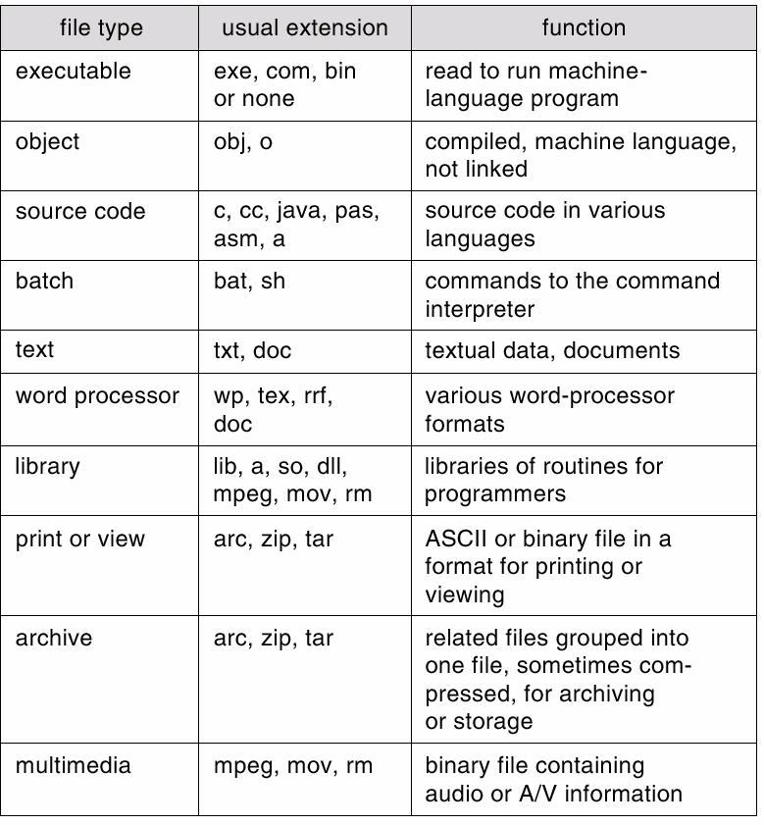
File Typed – Name, Extensions

Slide 10
File Attributes(Metadata)
A file has a name and data. Other than this, it contains information like date and time of file creation, file‘s current size etc. with a file. These are known as attributes of a file. The lists of file attributes are:
Name: The symbolic file name is the only information kept in human readable form.
Identifier: This unique tag, usually a number, identifies the file within the file system; it is the non-human-readable name for the file.
Type: This information is needed for systems that support different types of files.
Location: This information is a pointer to a device and to the location of the file on that device.
Size: The current size of the file (in bytes, words, or blocks) and possibly the maximum allowed size are included in this attribute.
Permission/Protection: Access-control information determines who can do reading, writing, executing, and so on.
Time, date, and user identification: This information may be kept for creation, last modification, and last use. These data can be useful for protection, security, and usage monitoring.

Slide 11
File Operations
CREATE: A blank file is created.
DELETE: The purpose of this system call is to delete this file
OPEN: Open a file either for reading or writing.
CLOSE: When a file is no longer accessed.
READ: When a file is only to be read.
WRITE: To write some data on file.
APPEND: To add some data to the end of the file.
RENAME: To rename the file.

Slide 12
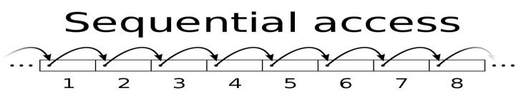
File Access Methods
File access mechanism refers to the manner in which the records of a file may be accessed. There are several ways to access files −
  Sequential access
  Direct/Random access
  Indexed sequential access
Sequential access
  A sequential access is that in which the records are accessed in some sequence, i.e., the information in the file is processed in order, one record after the other.
  This access method is the most primitive one.
  Example: Compilers usually access files in this fashion.

Slide 13
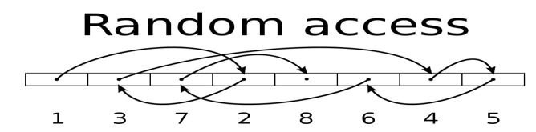
File Access Methods
Direct/Random access
  Random access file organization provides, accessing the records directly.
  Each record has its own address on the file with by the help of which it can be directly accessed for reading or writing.
  The records need not be in any sequence within the file and they need not be in adjacent locations on the storage medium.
  Example: Accessing file in hard disk

Slide 14
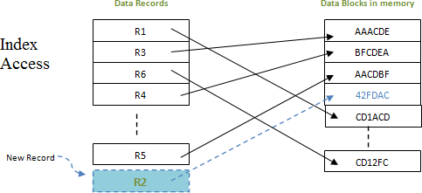
File Access Methods
Indexed sequential access (I-nodes)
  This mechanism is built up on base of sequential access.
  An index is created for each file which contains key field and pointers to various blocks.
  Index is searched sequentially and its pointer is used to access the file directly.
  Example: Accessing files in payroll system

Slide 15
Sharing
When several users are working together sharing of files takes place. In such a case it is convenient for a file to appear simultaneously in different directories belonging to different users. Sharing files is convenient but also introduces problems like if the original file or the shared file are appended with new features then it will not be updated in both the copies of the file, it is updated only at its original location. This way the purpose of file sharing is defeated. This problem can be solved by two ways:
  i-node
  Symbolic linking

Slide 16
Access Control List (ACL)
An access control list (ACL) is a table that tells a computer operating system which access rights each user has to a particular system object, such as a file directory or individual file.
When a user requests access to a particular file, the operating system checks the access list associated with that file. If that user is listed for the requested access, the access is allowed. Otherwise, a protection violation occurs, and the user job is denied access to the file.

Slide 17
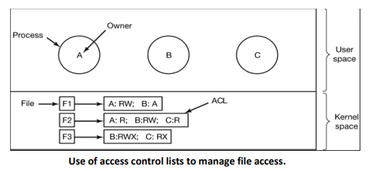
Access Control List (ACL)
Here we see three processes, each belonging to a different domain. A, B, and C, and three files F1, F2, and F3.
For simplicity, we will assume that each domain corresponds to exactly one user, in this case, users A, B, and C. Often in the security literature, the users are called subjects or principals, to contrast them with the things owned, the objects, such as files.

Slide 18
Access Control List (ACL)
Each file has an ACL associated with it. File F1 has two entries in its ACL (separated by a semicolon).
The first entry says that any process owned by user A may read and write the file. The second entry says that any process owned by user B may read the file.
All other accesses by these users and all accesses by other users are forbidden.
Note that the rights are granted by user, not by process. As far as the protection system goes, any process owned by user A can read and write file F1. It does not matter if there is one such process or 100 of them. It is the owner, not the process ID, that matters. File F2 has three entries in its ACL: A, B, and C can all read the file, and in addition B can also write it. No other accesses are allowed. File F3 is apparently an executable program, since B and C can both read and execute it. B can also write it.

Slide 19
Directories
Directory is the collection of files. The directory contains information about the files, including attributes, location and ownership.
The directory is itself a file, accessible by various file management routines.
Information contained in a device directory
  Name
  Type
  Address
  Current length
  Maximum length
  Date last accessed
  Date last updated
  Owner id
  Protection information

Slide 20
Directories
Directory Operations
CREATE: A directory is created.
DELETE: A directory is deleted.
OPENDIR: Directories can be opened for reading it.
CLOSEDIR: When a directory has been read, it should be closed to free up internal table space in main memory.
RENAME: Directories can be renamed just like files.
Advantages of maintaining directories
  Efficiency: A file can be located more quickly.
  Naming: It becomes convenient for users as two users can have same name for different files or may have different name for same file.
  Grouping: Logical grouping of files can be done by properties e.g. all java programs, all games etc.

Slide 21
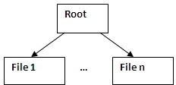
Types of Directories
Single Level Directory System
  In this type of directory system, there is a root directory which has all files.
  It has a simple architecture and there are no sub directories.
  Advantage of single level directory system is that it is easy to find a file in the directory.
  This type of directory system is used in cameras and phones.
  ALL file should have unique name.
  File is not distinguished by users.

Slide 22
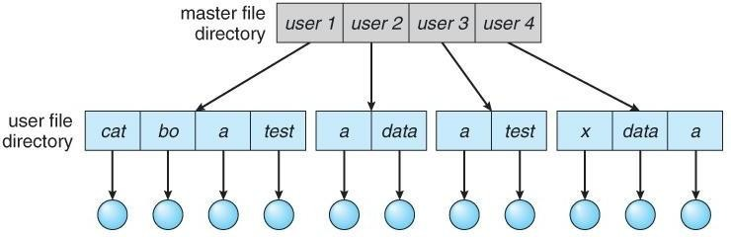
Types of Directories
Two-Level Directory
  Each user gets their own directory space.
  File names only need to be unique within a given user's directory.
  A master file directory is used to keep track of each users directory, and must be maintained when users are added to or removed from the system.
  A separate directory is generally needed for system ( executable ) files.
  Systems may or may not allow users to access other directories besides their own
    If access to other directories is allowed, then provision must be made to specify the directory being accessed.
    If access is denied, then special consideration must be made for users to run programs located in system directories. A search path is the list of directories in which to search for executable programs, and can be set uniquely for each user.

Slide 23
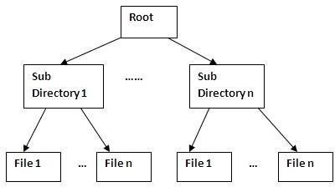
Types of Directories
Hierarchical Directory or Tree Directory
  In a hierarchical directory system, files are grouped together to form a sub directory.
  At the top of the hierarchy is the root directory and then there are sub directories which has files.
  Advantage of hierarchical directory system is that users can be provided access to a sub directory rather than the entire directory. It provides a better structure to file system. Also, managing millions of files is easy with this architecture.
  Personal computers use hierarchical directory system for managing files.

Slide 24
Path
A path is a unique location to a file or a folder in a file system of an OS.A path to a file is a combination of / and alpha-numeric characters.
Absolute Path-name:
An absolute path is defined as the specifying the location of a file or directory from the root directory(/).
  To write an absolute path-name:
  Start at the root directory ( / ) and work down.
  Write a slash ( / ) after every directory name (last one is optional) For example:
  grace /home/os/process.pdf
Relative path-name:
Relative path is defined as the path related to the present working directly. It starts at your current directory and never starts with a /.
  For example:
  If we are currently in home then, home/os/process.pdf is a relative path.

Slide 25
File System Implementation/Allocation
The allocation methods define how the files are stored in the disk blocks. There are three main disk space or file allocation methods.
i. Contiguous Allocation
ii. Linked Allocation
iii. Indexed Allocation
The main idea behind these methods is to provide:
  Efficient disk space utilization.
  Fast access to the file blocks

Slide 26
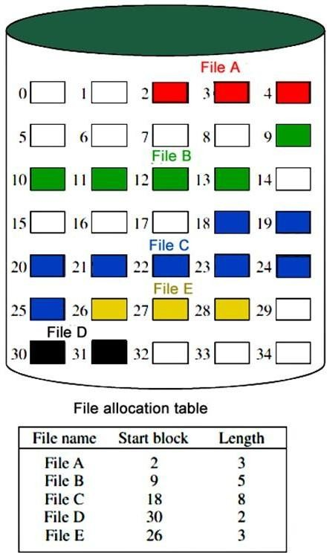
Contiguous Allocation
In this scheme, each file occupies a contiguous set of blocks on the disk. For example, if a file requires n blocks and is given a block b as the starting location, then the blocks assigned to the file will be: b, b+1, b+2,……b+n-1. This means that given the starting block address and the length of the file (in terms of blocks required), we can determine the blocks occupied by the file.
For example, If we have a disk with 1 KB blocks, then for storing a 50 KB file, we will require 50 consecutive blocks.
The file allocation table in contiguous allocation contains
  Address of starting block
  Length of the allocated portion.
The file ‘File A’ in the above figure starts from the block 2 with length = 3 blocks. Therefore, it occupies 2,3 and 4 blocks.

Slide 27
Contiguous Allocation
Advantages:
  Both the Sequential and Direct Accesses are supported by this.
  This is extremely fast since the number of seeks are minimal because of contiguous allocation of file blocks.
Disadvantages:
  This method suffers from both internal and external fragmentation. This makes it inefficient in terms of memory utilization.
  Increasing file size is difficult because it depends on the availability of contiguous memory at a particular instance.

Slide 28
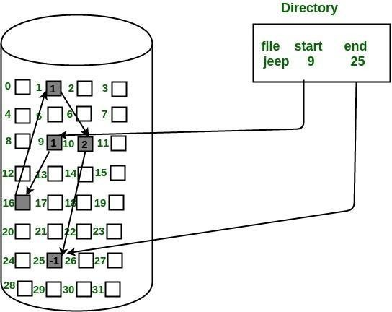
Linked Allocation (Non-contiguous allocation)
In this scheme, each file is a linked list of disk blocks which need not be contiguous.
The disk blocks can be scattered anywhere on the disk.
The file allocation table contains a pointer to the starting and the ending file block.
Each block contains a pointer to the next block occupied by the file.
The file ‗jeep‘ in following image shows how the blocks are randomly distributed.
The last block (25) contains -1 indicating a null pointer and does not point to any other block.

Slide 29
Linked Allocation (Non-contiguous allocation)
Advantages:
  This is very flexible in terms of file size..
  Better in terms of memory utilization.
Disadvantages:
  Linked allocation are slower.
  It does not support random or direct access.
  Pointers required in the linked allocation incur some extra overhead.

Slide 30
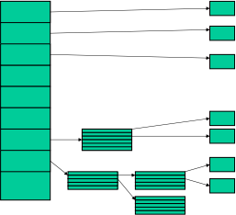
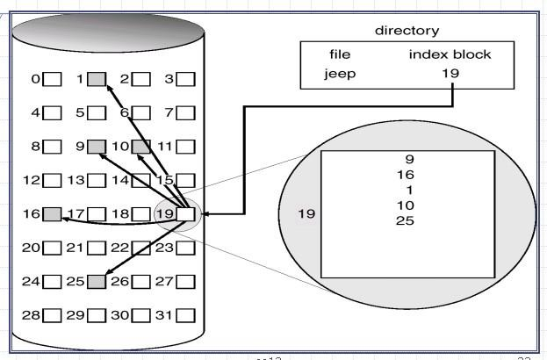
Indexed Allocation (i-nodes)
In this scheme, a special block known as the Index block contains the pointers to all the blocks occupied by a file.
Each file has its own index block.
The ith entry in the index block contains the disk address of the ith file block.
The directory entry contains the address of the index block as shown below:
I- nodes can point directly or indirectly as follows:

Slide 31
Indexed Allocation (i-nodes)
Advantages:
This supports direct access to the blocks occupied by the file and therefore provides fast access to the file blocks.
It overcomes the problem of external fragmentation.
Disadvantages:
The pointer overhead for indexed allocation is greater than linked allocation.
For very small files, say files that expand only 2-3 blocks, the indexed allocation would keep one entire block (index block) for the pointers which is inefficient in terms of memory utilization. However, in linked allocation we lose the space of only 1 pointer per block.

Slide 32
Blocking And Buffering
A physical record or block is the unit of information actually read from or written to a device. A logical record is a collection of data treated as a unit from the user’s standpoint. When each physical record contains exactly one logical record, the file is said to consist of unblocked records.
When each physical record may contain several logical records, the file is said to consist of blocked records. In a file with fixed-length records, all records are the same length; the block size is ordinarily an integral multiple of the record size. In a file with variable- length records, records may vary in size up to the block size.

Slide 33
Blocking And Buffering
Buffering allows computation to proceed in parallel with input/output. Spaces are provided in primary storage to hold several physical blocks of a file at once – each of these space is called buffer.
The most common scheme is called double buffering and it operates as follows(for output). There are two buffers. Initially, records generated by a running process are deposited in the first buffer until it is full.
The transfer of block in the first buffer to secondary storage is then initiated. While this transfer is in progress, the process continues generating records, that are deposited in the second buffer.
When the second buffer is full, and when the transfer from first buffer is complete, transfer from second buffer is initiated.
The process continues generating records that are now deposited in the first buffer. This alternation between the buffers allows input/output to occur in parallel with a process’s computations.

Slide 34
Security and Multi-media files
Security:
Security refers to providing a protection system to computer system resources such as CPU, memory, disk, software programs and most importantly data/information stored in the computer system. If a computer program is run by an unauthorized user, then he/she may cause severe damage to computer or data stored in it. So a computer system must be protected against unauthorized access, malicious access to system memory, viruses, worms etc.
Multi-media files:
A file that is capable of holding two or more multimedia elements (text, images, audio, video and animations) is known as multimedia files.
Although still images are a different medium than text, multimedia is typically used to mean the combination of text, sound, and/or motion video.

